Slide 1
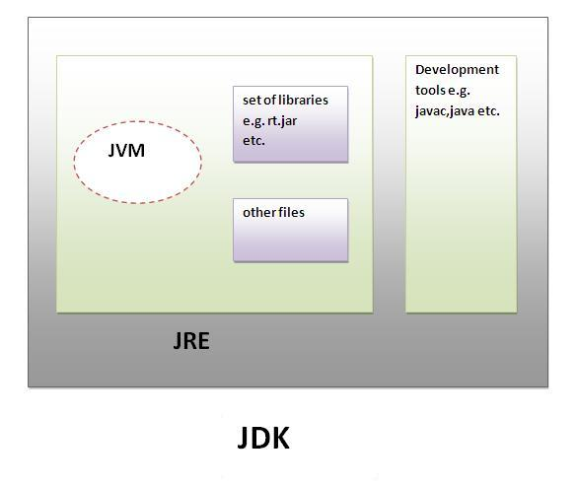
JDK
JDK is an acronym for
Java Development Kit.
It physically exists.
It contains JRE + Development Tools.

Slide 2
JRE
JRE is an acronym for Java Runtime Environment. It is used to provide runtime environment. It is the implementation of JVM. It physically exists. It contains set of libraries + other files that JVM uses at runtime.
Implementation of JVMs are also actively released by other companies besides Sun Micro Systems.

Slide 3
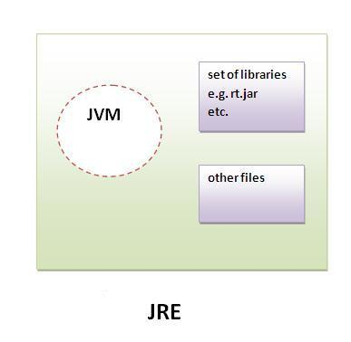
JRE

Slide 4
JVM
JVM (Java Virtual Machine) is an abstract machine. It is a specification that provides runtime environment in which java bytecode can be executed.
JVMs are available for many hardware and software platforms. JVM, JRE and JDK are platform dependent because configuration of each OS differs. But, Java is platform independent.

Slide 5
Loads Code
Verifies Code
The JVM
Performs
Main Tasks
Executes Code

